Slide 1
Physics mini PROJECT project

Slide 2
WIRELESS ENERGY TRANSFER

Slide 3
64
65
66
JISHANT VYAS
TANIYA VARTAK
HARSSH WAREKAR
WIRELESS ENERGY TRANSFER
67
KUNAL YADAV

Slide 4

VIDYAVARDHINI’S COLLEGE OF ENGINNERING AND TECHNOLOGY

Slide 5
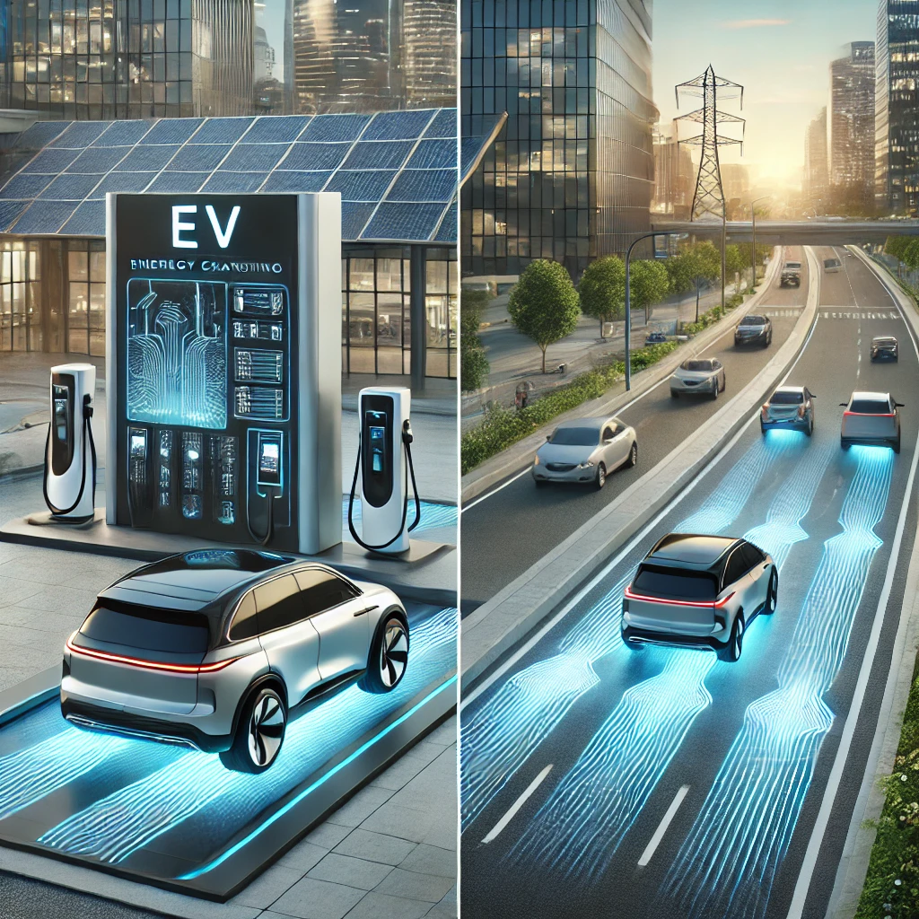

Slide 6
BASIC PRINCIPLES

Slide 7
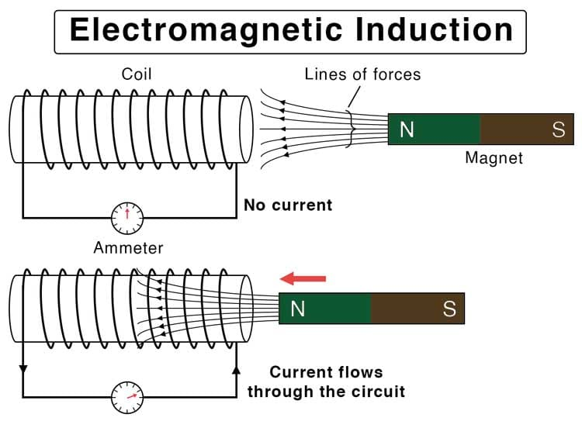
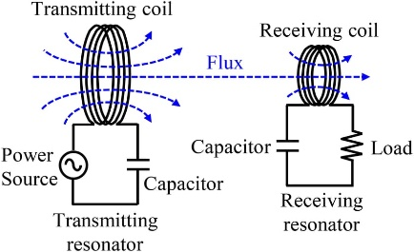
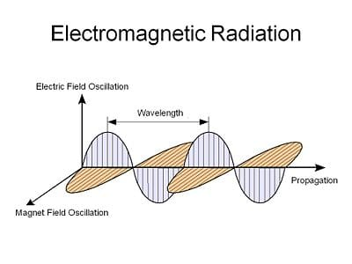
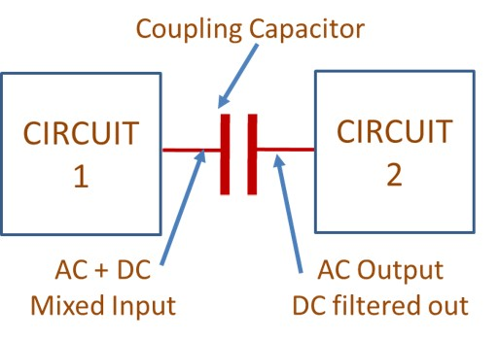
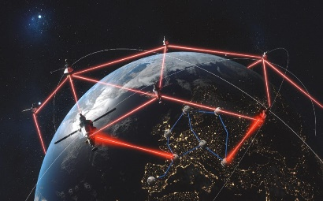
BASIC PRINCIPLES
ELECTROMAGNETIC INDUCTION
RESONANT INDUCTIVE COUPLING
ELECTROMAGNETIC RADIATION
CAPACITIVE COUPLING
Laser-Based Transmission

Slide 8
INDUCTIVE POWER TRANSFER

Slide 9
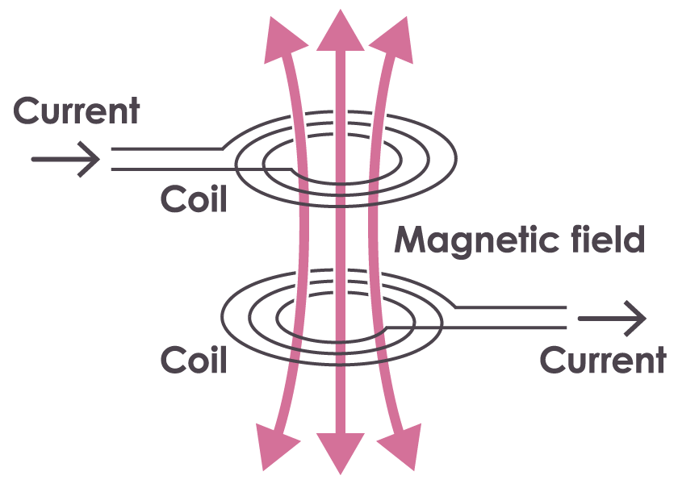
INDUCTIVE POWER TRANSFER

Slide 10
COMPONENTS

Slide 11
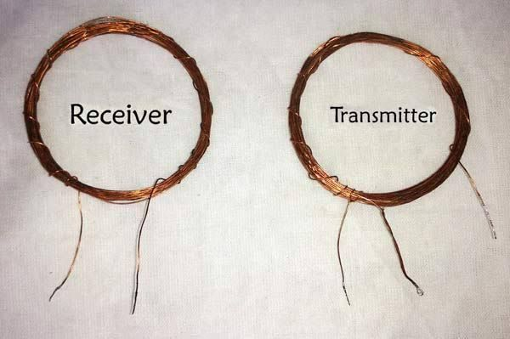
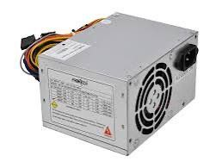
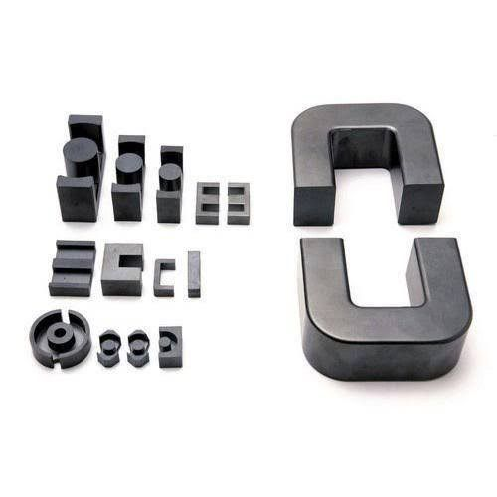
COMPONENTS
POWER SUPPLY
TRANSMITTER ANS RECEIVER COILc
POWER SUPPLY
FERRITE CORE MATERIAL

Slide 12


Slide 13
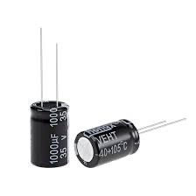
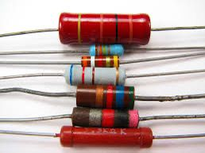
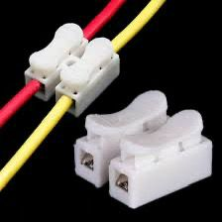
,LL
CAPACITORS
RESISTORS
WIRES AND CONNECTORS

Slide 15
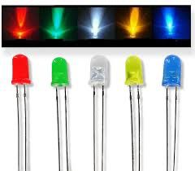

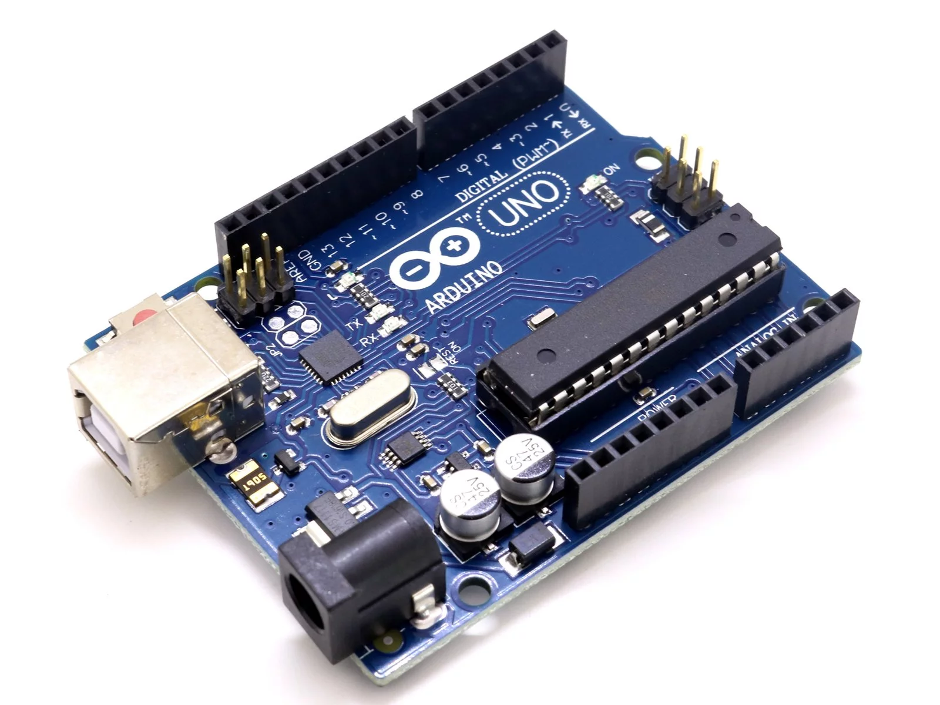
LEDs
CARDBOARD
ARDINO UDINO

Slide 16
ADVANTAGES AND DISADVANTAGES

Slide 17
ADVANTAGES AND DISADVANTAGES
ADVANTAGES
DISADVANTAGES
1)Lower Power Capacity
2)Interference and Reliability
3)Cost of Technology
1)Convenience and Flexibility.
2)Improved Safety and Durability.
3)Potential for New Applications and Efficiency.

Slide 19

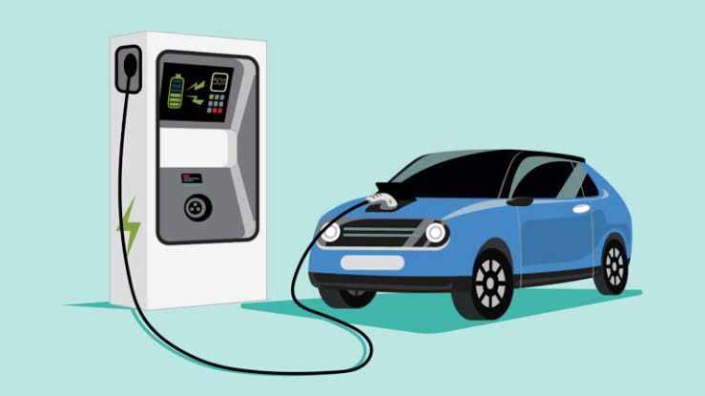
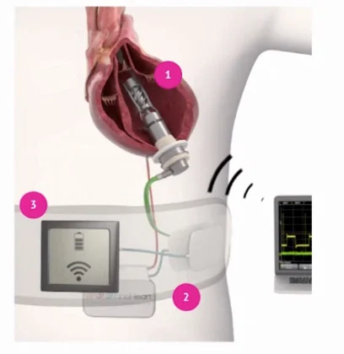
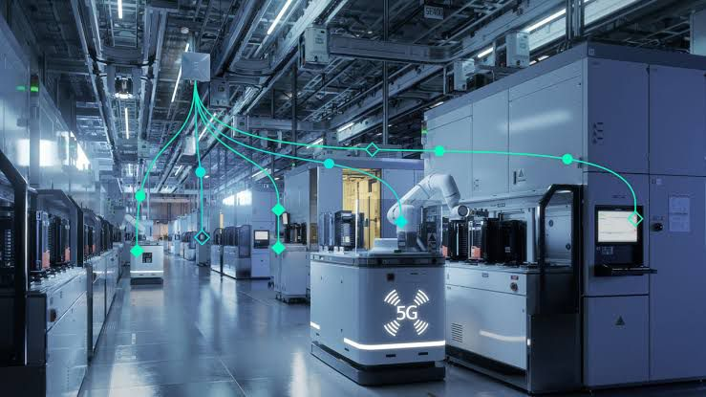
Consumer Electronics
1)Inductive systems like Qi
2)Advancements in WE
Electric Vehicles (Ev’s)
1)Eliminates the need for plugging
2)Addresses range anxiety
Medical Devices
1)Implants like pacemaker
2)Minimizing the need for surgeries
Industrial Use
1)Improves safety
2)Continuous operation of equipment

Slide 20
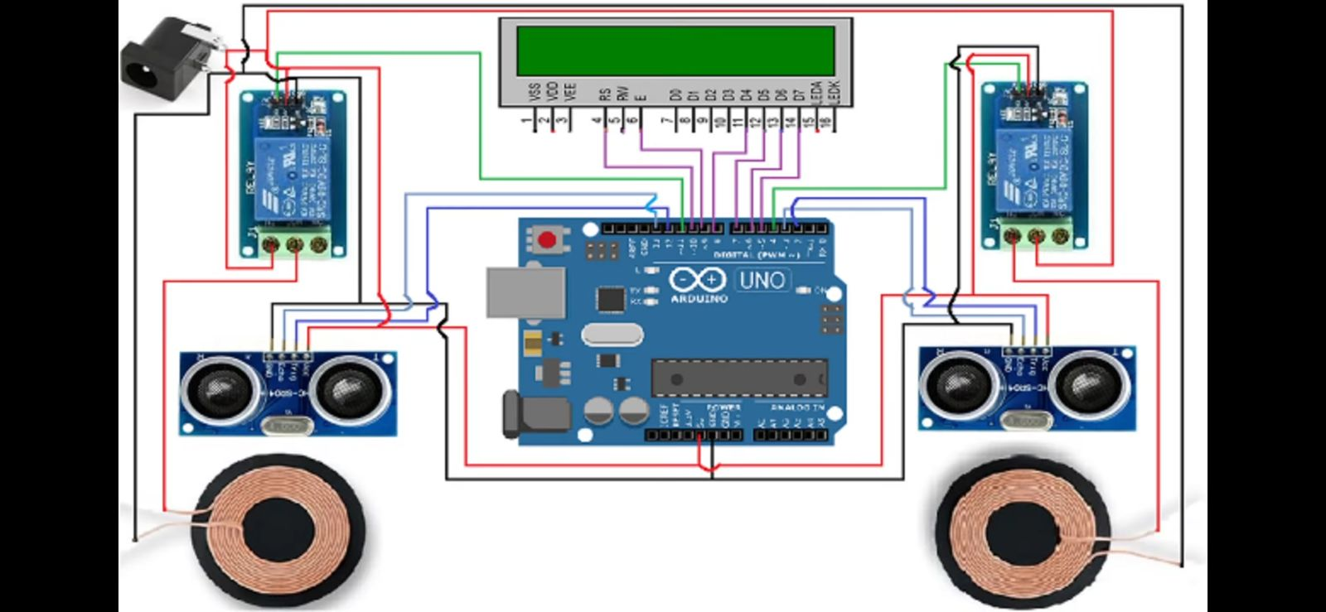
WIRELESS CHARGING STATION

Slide 22
WORKING

Slide 23
WORKING
Inductive Power Transfer Principle
Transmitter and Receiver Coil Design
Transmitter Circuit Assembly
Receiver Circuit Setup

Slide 24
Increased Efficiency and Range
Smarter Wireless Charging Stations
Dynamic Charging Roads
Renewable Energy Integration
Safety and Standardization
Autonomous and Public Transport Integration

Slide 25

Where does the energy go?
Conservation of Energy
THANK YOU
THANK YOU

